Slide 1

K. S. INSTITUTE OF TECHNOLOGY BENGALURU - 560109
Affiliated to VTU, Belagavi & Approved by AICTE, New Delhi, (AccreditedbyNAAC&1E1) Department of Computer Science and Engineering
Project Phase -2 + Seminar Review 1
(15CSP85)
Behavioural Based Students Stress Detection with Attendance Management System
Batch No: 2020_CSE_23
Under the guidance of: Sharada A 1KS15CS128
Dr. Rekha B Venkatapur Laxmi K V 1KS15CS050
Prof. & Head, CSE Shashank Kavur 1KS16CS090
Adarsh Shreshta 1KS15CS125
Date:17/5/21
1
1

Slide 2
Content:
Introduction
Literature survey
Problem Statement
Challenges
Motivation.
References (Bibliography)

Slide 3
Introduction
Face recognition is a biometric technique which involves determining if the image of the face of any given person matches any of the face images stored in a database.
This problem is hard to solve automatically due to the changes that various factors, such as facial expression, aging and even lighting, can cause on the image.
Among the different biometric techniques facial recognition may not be the most reliable but it has several advantages over the others.
It is widely used in various areas such as security and access control, forensic medicine, police controls and in attendance management system.

Slide 4
Introduction
The various techniques for marking attendance are:
1) Signature based System
2) Fingerprint based System
3) Iris Recognition
4) RFID based System
5) Face Recognition

Slide 5
Literature survey
Title 1: “Design and Implementation of an Algorithm for Face Recognition using Principal Component Analysis in MATLAB”
Authors: K. Sai Prasad Reddy and Dr.K. Nagabhushan Raju
In the beginning face recognition was treated as a 2D pattern recognition problem. The following Three methods are used to face recognition.
1. Holistic Matching Methods : In holistic matching method, the complete face region is taken as input data into face catching system.

Slide 6
Contd..
2. Feature-based (structural) Methods : : In this methods local features such as eyes, nose and mouth are extracted first and their locations and local .
3. Hybrid method: Hybrid face recognition systems use a combination of both holistic and feat

Slide 7
Contd..
Title 1: “Face Recognition using Principal Component Analysis with DCT”
Authors: Kiran D. Kadam EandTC Department, Dr.D.Y.Patil College of Engineering, Pune University, Ambi-Pune
In this paper two technologies are PCA and DCT are combined. Two methods PCA and DCT have certain mathematical similarities since that they both aim to reduce the dimensions of data.
Initially we will use DCT which is useful to compress the input image, then PCA is entered to reduce the dimensions and the final recognition or classification is done using the Euclidian distance formula.

Slide 8
Contd..
Title 2: “Face Recognition using PCA, LDA and ICA approaches on colored images”
Authors: Önsen TOYGAR Adnan ACAN Computer Engineering Department, Eastern Mediterranean University, Famagusta, Turkish Republic of Northern Cyprus, Mersin 10, Turkey.
The results of the experiments show that PCA is better than LDA and ICA in general and under different illumination variations.
It is also demonstrated that LDA is more sensitive than PCA and ICA on partial occlusions, but PCA is less sensitive to partial occlusions comparisons

Slide 9
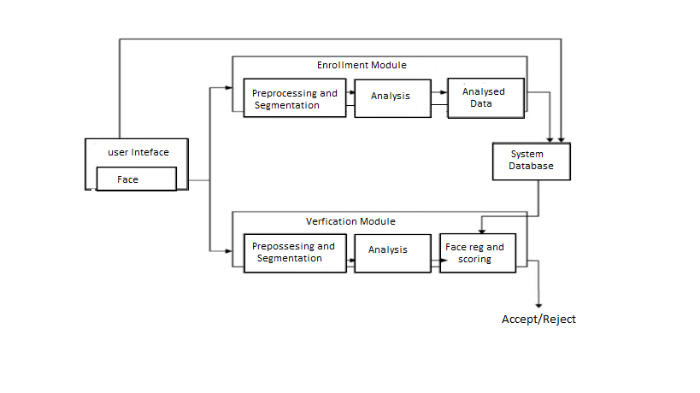
Methodology
Fig: Face Recognition process

Slide 10
Contd..
The proposed face recognition system overcomes certain limitations of the existing face recognition system.
It is based on extracting the dominating features of a set of human faces stored in the database and performing mathematical operations on the values corresponding to them.
Hence when a new image is fed into the system for recognition the main features .
Thus, some variations in the new face image to be recognized can be tolerated.

Slide 11
Problem Statement .
As accordingly to the previously invention mouse motion through eye blink was possible but the circumstances that occurred were the small blink or shorts blink were neglected. Even hardware was used for detecting eye blinks but it used to cause a eye damage.
Our system uses only webcam for detecting face and eye movements and microphone for voice recognition to give better output.

Slide 12
Challenges .
Illumination
Background
Pose
Occlusion
Expressions
Complexity

Slide 13
MATLAB WORKING
After logging into your account, you can enter Matlab by double-clicking on the Matlab shortcut icon (Matlab 8.1) on your Windows desktop. When you start Matlab, a special window called the Matlab desktop appears. The desktop is a window that contains other windows. The major tools within or accessible from the desktop are:
• The Command History
• The Workspace
• The Current Directory
• The Help Browser
• The Start button

Slide 14
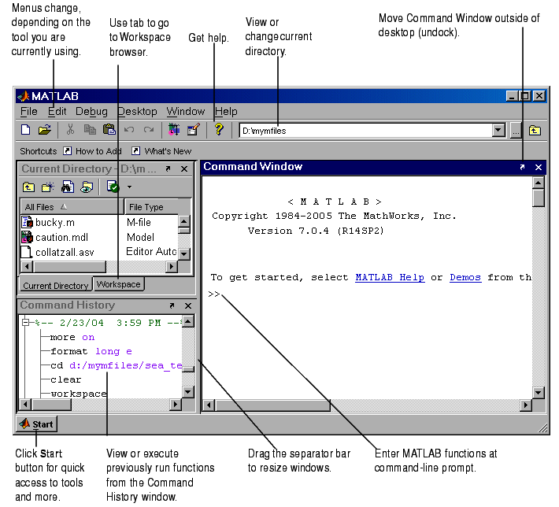
Graphical interface to the MATLAB workspace

Slide 15
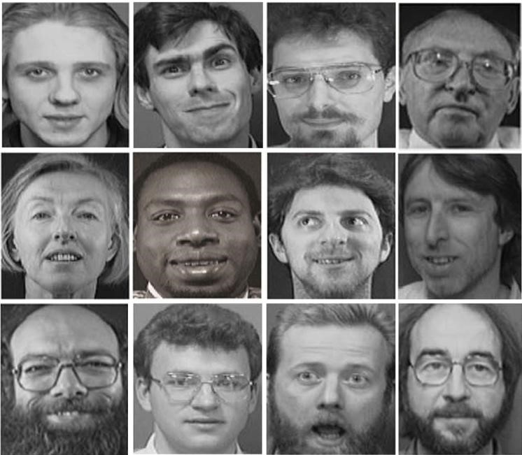
Fig: Pictures from Training Database

Slide 16
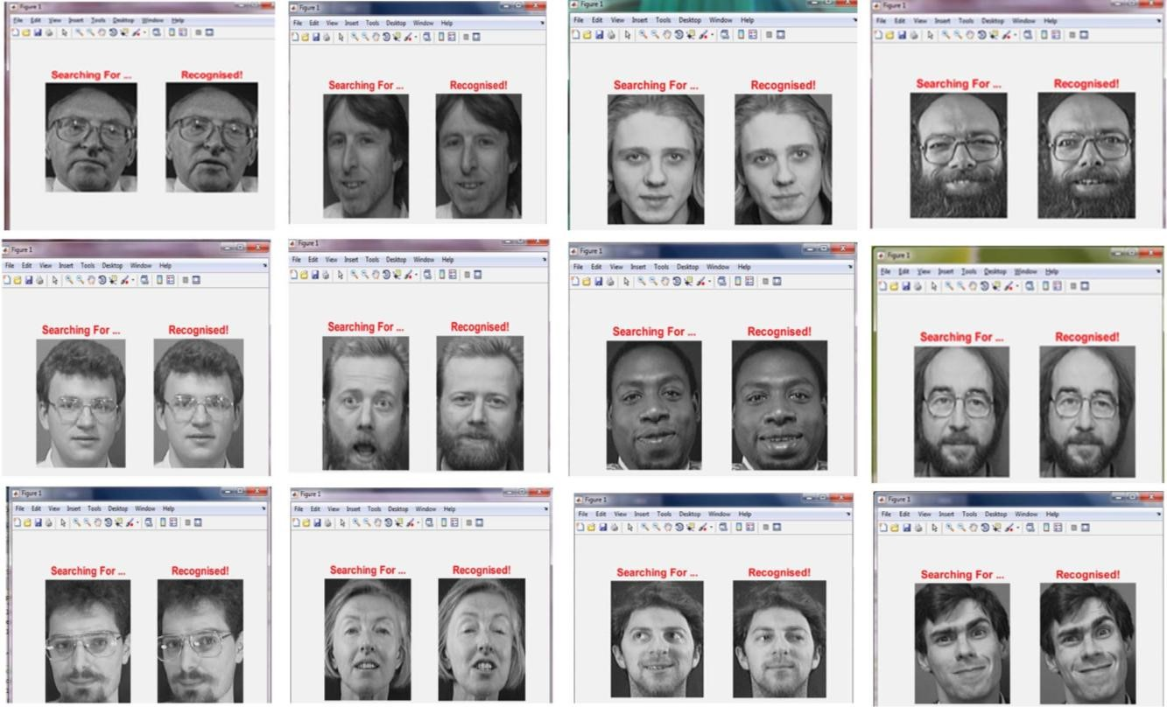
Fig: Tested and Recognized images from Training Database

Slide 17
Implementation of Module:
We are setting up to design a system comprising of two modules.
The first module (face detector) is a mobile component, which is basically a camera application that captures student faces and stores them in a file using computer vision face detection algorithms and face extraction techniques.
The second module is a desktop application that does face recognition of the captured images (faces) in the file, marks the students register and then stores the results in a database for future analysis.

Slide 18
References
[1]. Shireesha Chintalapati; M. V. Raghunadh, "Automated Attendance Management System Based On Face Recognition Algorithms", 2013 IEEE International Conference on Computational Intelligence and Computing Research.
[2]. Phichaya Jaturawat; Manop Phankokkruad, "An Evaluation of Face Recognition Algorithms and Accuracy based on Video in Unconstrained Factors", 2016 6th IEEE International Conference on Control System, Computing and Engineering (ICCSCE)
[3]. Abhishek Jha: ABES Engineering College, Ghaziabad, "Class Room Attendance System Using Facial Recognition System", The International Journal of Mathematics, Science, Technology and Management (ISSN : 2319-8125) Vol. 2 Issue 3
[4]. S. SAYEED, J. HOSSEN, S.M.A. KALAIARASI, V. JAYAKUMAR, I. YUSOF, A. SAMRAJ, "Real-Time Face Recognition For Attendance Monitoring System" Journal of Theoretical and Applied Information Technology 15th January 2017. Vol.95. No.1
[5]. Ashish Choudhary, Abhishek Tripathi, Abhishek Bajaj, Mudit Rathi, and B.M Nandini, "Attendance System Using Face Recognition", International Journal of Modern Trends in Engineering and Research (IJMTER) Volume 03, Issue 04, [April– 2016] ISSN (Online):2349–9745; ISSN (Print):2393-8161

Slide 19
Links:
Blogs link:
https://sharadaksit.blogspot.com/2021/04/cse2021023.html
Github link:
https://github.com/sharada931/blogs.git

Slide 20
Thank you

